Slide 1
Introduction to GAN’s
Rinda Digamarthi

Slide 2
Contents
What are GAN’s
History of GAN
How GAN’s work
Why use GAN’s
Applications of GAN

Slide 3
What are GAN
GAN are short for General Adversarial networks
It is a Unsupervised Learning task
Generates new examples
Generative Adversarial Networks (GANs) can be broken down into three parts:
Generative: To learn a generative model, which describes how data is generated in terms of a probabilistic model.
Adversarial: The training of a model is done in an adversarial setting.
Networks: Use deep neural networks as the artificial intelligence (AI) algorithms for training purpose.

Slide 4
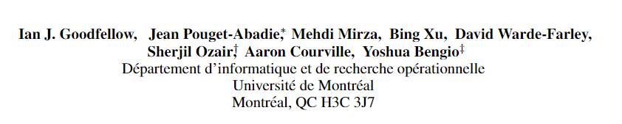
History of GAN
The first paper specifically on GANs as a generative model was published by Ian Goodfellow, et al. in 2014.
It was titled ‘Generative Adversarial Networks’
The paper presents the general technique and demonstrates it with some simple examples of generating images from MNIST (handwritten digits), CIFAR-10 (small photographs), and faces.
Deemed as the most interesting idea in the last 10 years in ML.

Slide 5
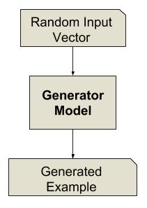
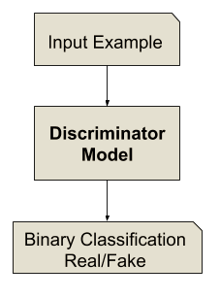
How GAN’s work
A GAN Model consists of 2 sub models
Generator model - which we train to generate new examples
Discriminator model - which tries to classify examples as either real or fake

Slide 6
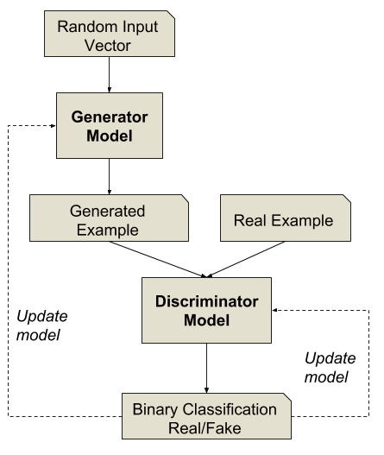
Architecture of basic GAN
Both are compared

Slide 7
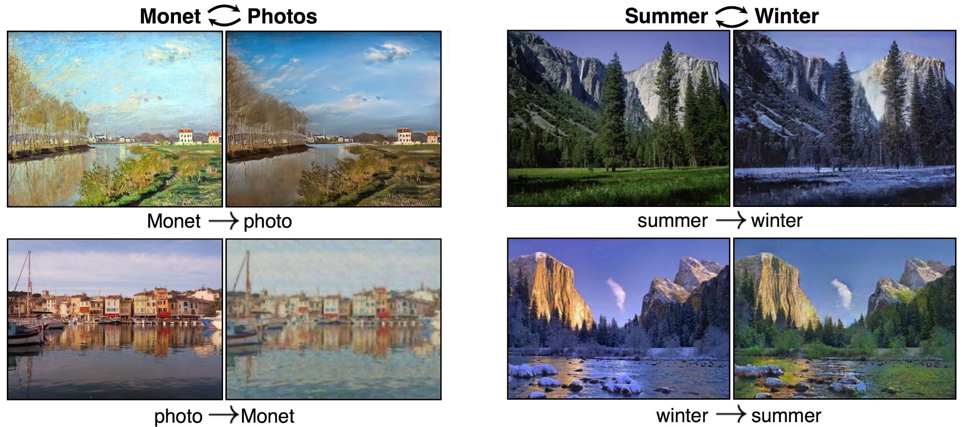
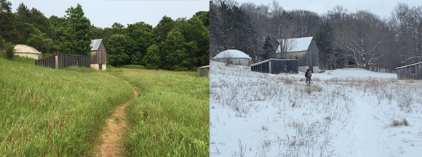
Why use GAN’s
Ability to generate the realistic examples across a large range of domains
Generating photorealistic which we can't tell are fake
Inter domain relationships

Slide 8
Applications of GAN
Cycle GAN
Star GAN
Pixel DT GAN
Super Resolution GAN
Stack GAN
Disco GAN
Age-cGAN
Music Generation
Medical anomaly detection

Slide 9
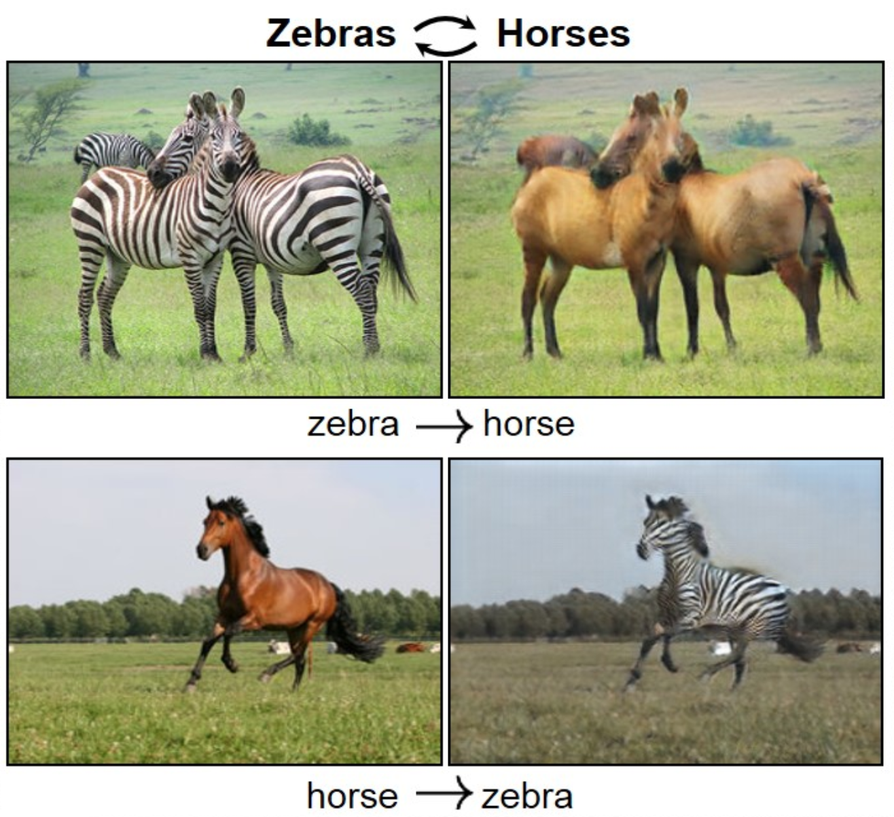
CycleGAN
Cross domain transfers – transforming images from one domain to another

Slide 10
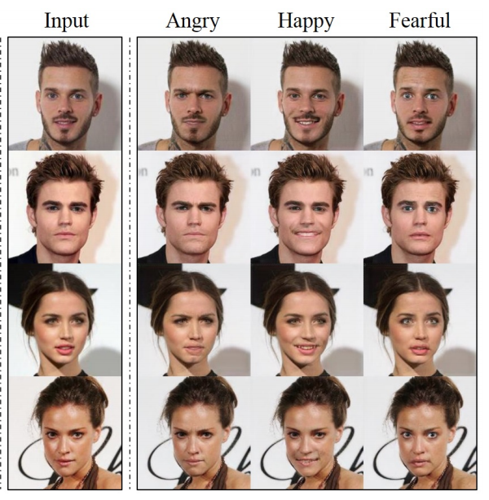
Star GAN
A image to image translation from one domain to another

Slide 11
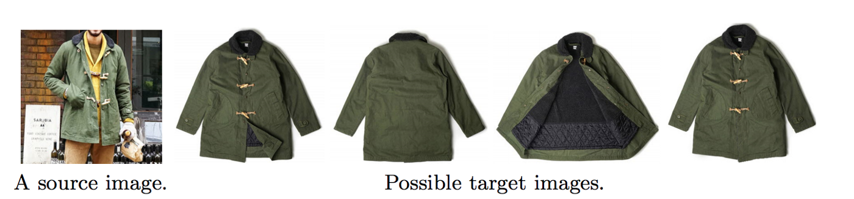
Pixel DT GAN
Extracting selected features from the given image
E.g: Suggesting merchandise from the celebrity pictures

Slide 12
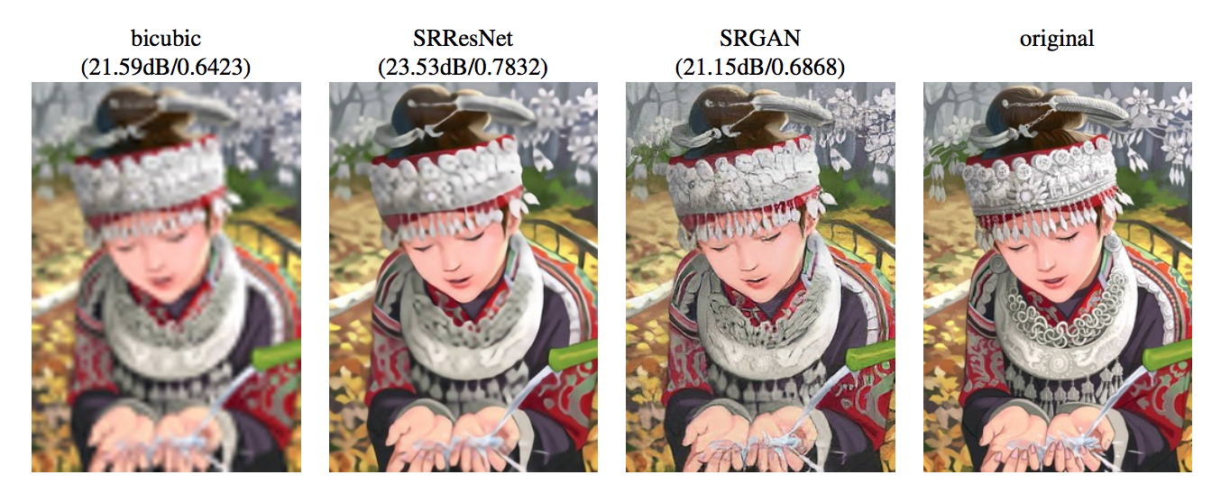
Super Resolution GAN
Creates super resolution images from lower resolution images
This is the mostly used type of GAN

Slide 13
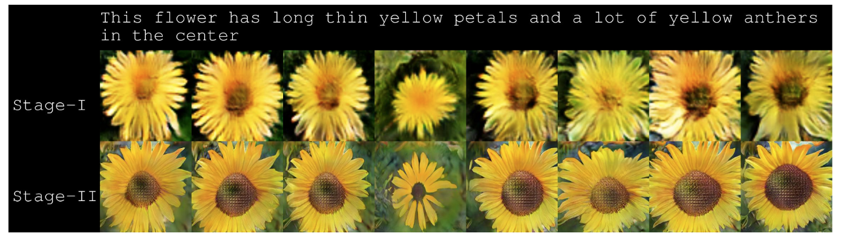
Stack GAN
This is a text to image GAN

Slide 14
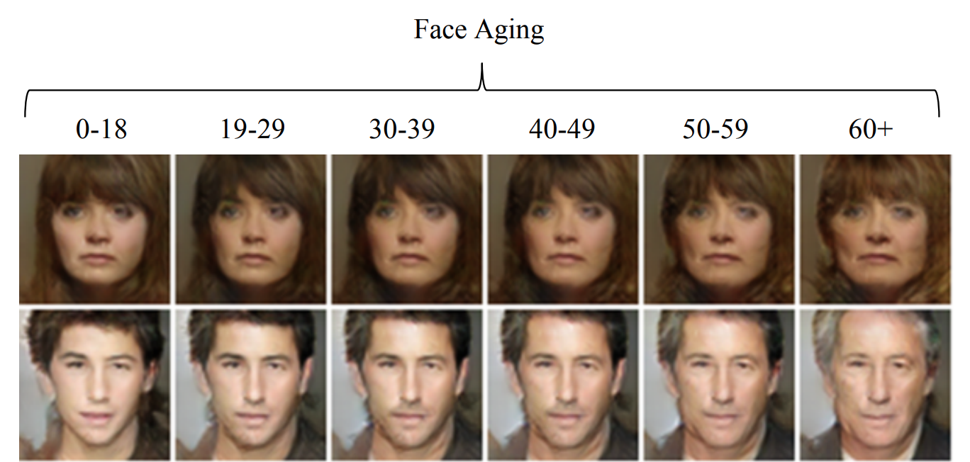
Age- cGAN
Used for aging of the faces with input attribute

Slide 15
Some more GAN applications are :
Generating new logo for businesses
Generating new fashion of clothes
Translating daytime photo to nighttime photo
Colorization of black and white photographs
Generate or predict future sequences of video frames for training reinforcement learning models

Slide 16
Thank you

Slide 17
Questions?

